Slide 1
A Machine Learning Image Analysis Approach to Improve Early Prediction of Preterm Birth
BIDH5002 Digital Health and Data Science Capstone
Project Presented By: Vernise Ang Veng Yan / 540288036
In Collaboration With: Royal Prince Alfred Hospital

Slide 2
Table of Contents
01
02
03
04
Motivation and Objectives
Background and Related Work
Methods
Next steps

Slide 3
Why is the automation of preterm birth risk prediction important?

Slide 4
MOTIVATION
01
Past Trend
North Territory PTB rate ^{[1]} :
Severity
In 2020, 15 million babies were born preterm ^{[2]}
Potential Solution
Early detection and intervention is crucial
In 2020: 11.4%
In 2010: 10.6%
=11.1% of all live births
35% of annual neonatal deaths
No improvement, slight increase in some regions!!
Novel predictors: Uterocervical angle and Cervical length
Notes:
PTB rates are highest in the Northern Territory (NT).
most common cause of death for children under five years of age

Slide 5
OBJECTIVES
01
Investigate the importance of predicting preterm birth risk and explore its potential practical applications.
Explore the feasibility of using a machine learning model to predict the risk of preterm birth using uterocervical angle and cervical length as key predictors.
Automate the detection of uterocervical angle and cervical length from transvaginal ultrasound images.

Slide 6
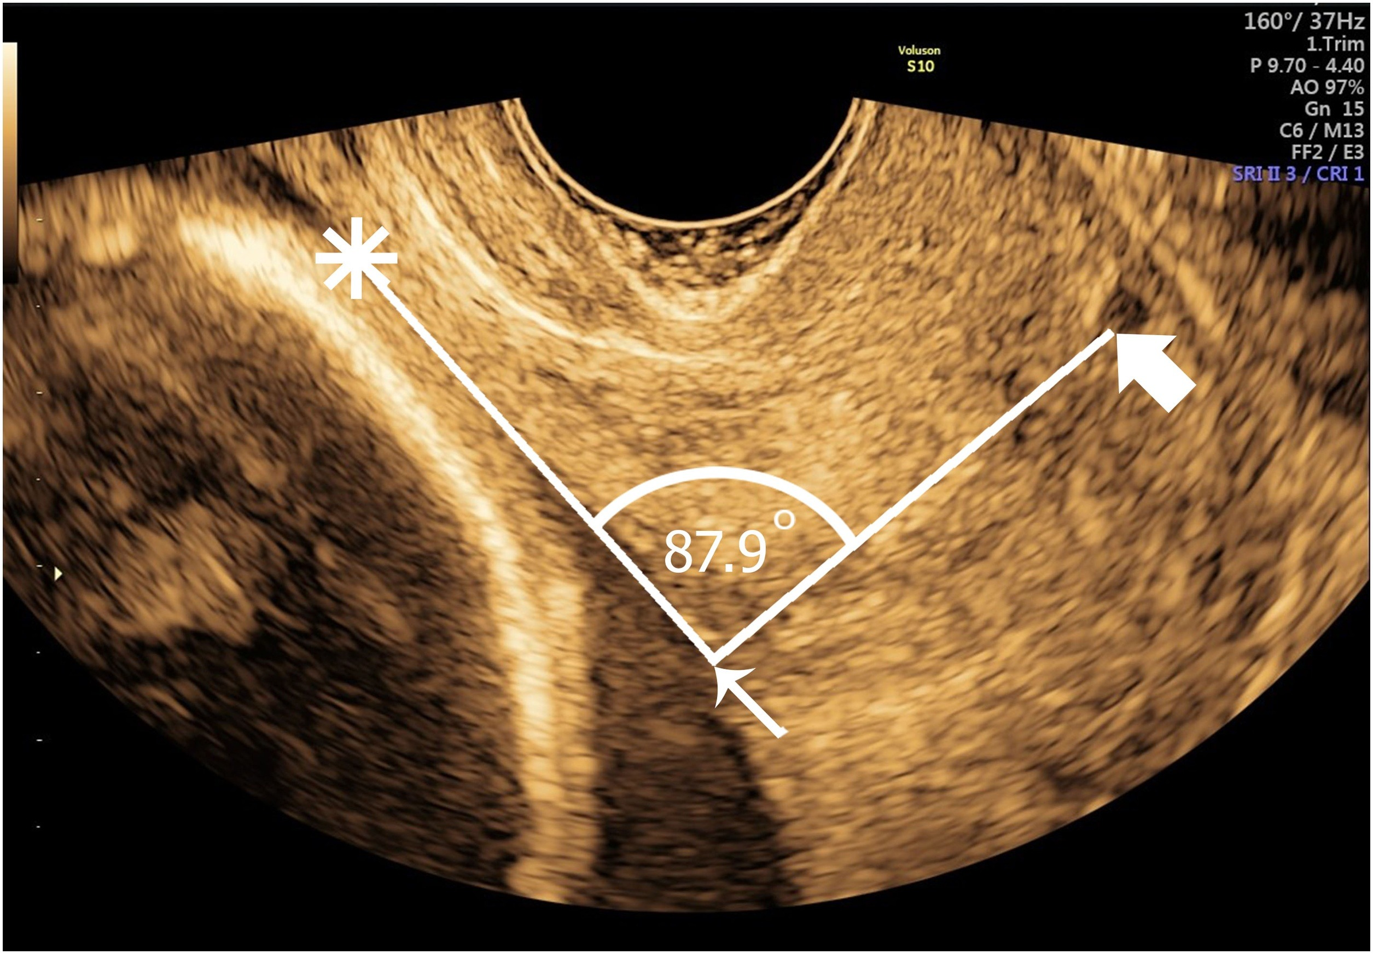
02
bACKGROUND
Current solution ^{[3]} :
Transvaginal ultrasound examination: The probe is inserted along the vaginal axis, meeting the cervix's anterior lip at the anterior fornix, perpendicular to the cervical canal
Cervical length: 1st ray is placed from the internal os to the external os. Calipers are placed where the anterior and posterior walls of the cervix touch the internal and external os along the endocervical canal.
2nd ray is drawn to delineate the lower uterine segment
The anterior angle (Uterocervical Angle) between the 2 rays was measured with a protractor.

Slide 7


02
bACKGROUND
Machine Learning in Medical Imaging ^{[4]} :
Improve decision support in medical image interpretation and improve efficiency
2014
2016
2017
2020
VGG19
GoogLeNet
ResNet
DenseNet
EfficientDet

Slide 8
02
RELATED WORK
Research by Sochacki-Wojcicka ^{[5]} showed significant differences in the median UCA between preterm and full-term pregnancies
Median UCA of preterm group :126°
Median UCA of full-term group: 91.5°
Wider UCA = Higher preterm birth risk
Sotiriadis et al. ^{[6]} stated that a short cervix(< 15 mm) increases the chances of delivering within 1week by 5.7 times
Shorter CL = Higher preterm birth risk
Some research by suggested that UCA is a better predictor than CL ^{[7][8]}
Multiple research suggested the combination of UCA and CL measurements to be used in predictive models ^{[5][8][9][10]}
No additional cost to determine UCA from CL measurement

Slide 9
02
RELATED WORK
Research paper | Model | Predictors | P-value | Sensitivity (%) | Specificity (%) | PPV (%) | NPV (%)
Luechathananon S. et al. ^{[8]} | Logistic Regression | CL<3.4 cm | 0.29 | 72.1 | 46.2 | 33 | 81.8
 |  | UCA≥110.97° | 0.77 | 65.1 | 43.6 | 29.8 | 77.3
 |  | UCA≥110.97° & CL<3.4 cm | 0.80 | 48.8 | 68.4 | 36.2 | 78.4
Dziadosz M. et al. ^{[3]} | Linear Regression | UCA>105° | <0.001 | 81 | 65 | 10 | 99
 |  | CL≤25 mm | <0.001 | 98 | 29 | 29 | 96
 |  | UCA>105° & CL≤25 mm | <0.001 | 23 | 98 | 48 | 97
Nguyen TTH. et al. ^{[10]} | Logistic regression | UCA≥99° | <0.001 | 91 | 76 | 19 | 99
 |  | CL≤33.8 mm | <0.001 | 25 | 66 | 5 | 93
 |  | UCA≥99° & CL≤33.8 mm | <0.001 | 66 | 93 | 36 | 98
When combined UCA with CL, sensitivity decreases but specificity increases. Rules out term pregnancies more reliably. Others should be monitored for preterm.

Slide 10
02
RELATED WORK
Object detection models on transvaginal ultrasound:
Use U-Net to perform segmentation on endometrium (Singhal, 2017)
Use U-Net estimate the surface of the ovarian volume (Narra, 2018)
Compare performance of VGG16, InceptionV3, ResNet50, and ResNet101 to classify intrauterine adhesion (IUA) and non-IUA patients (Zhao, 2023)
Use SSD and DAR-SSD for the detection and recognition of cervical cancer region (Wei, 2019)
EfficientDet in medical imaging:
Breast ultrasound tumour detection (Liu, 2022)
Automatic Detection of Uterine Fibroids (Yang, 2022)
Vessel Detection (Nguyen, 2023)
Literature Gap: No published paper on automatic prediction of preterm birth risk using transvaginal ultrasounds, but related research reveals opportunities

Slide 11
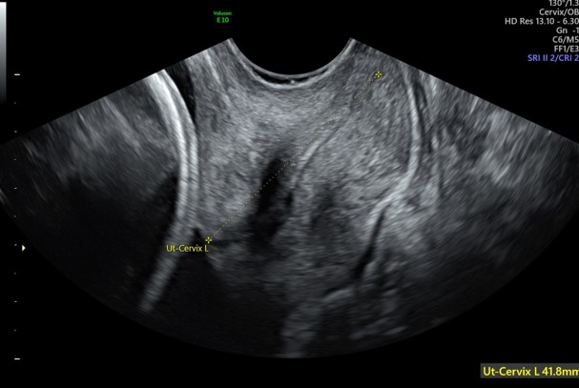
03
Methods
Data collection
Object detection model
Angle and length calculation algorithm
Machine learning model
Transvaginal Ultrasound Images

Slide 12
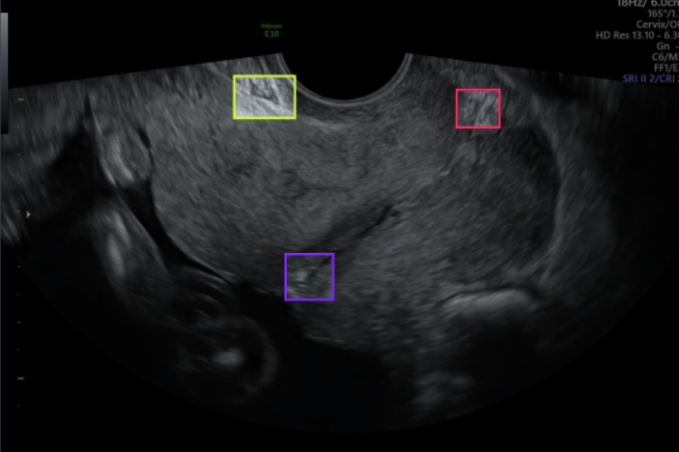
DATA COLLECTION
Public dataset + hospital
71 images
Training: 70%, Testing: 20%, Validation: 10%
Ensure fairness for both datasets
Images were uploaded to the Roboflow platform
Data annotation:
Labels: inner uterine wall, external ostium and internal ostium
Pre-processing
Auto-orient
Resize: 1000 x 600
Augmentation
Rotate: -15° ~ +15°
Exposure: -10% ~ +10%
After augmentation: 147 images for training
Model deployment
 | Public dataset | Hospital
Training | 34 | 15
Validation | 5 | 3
Testing | 9 | 5
Total | 48 | 23

Slide 13
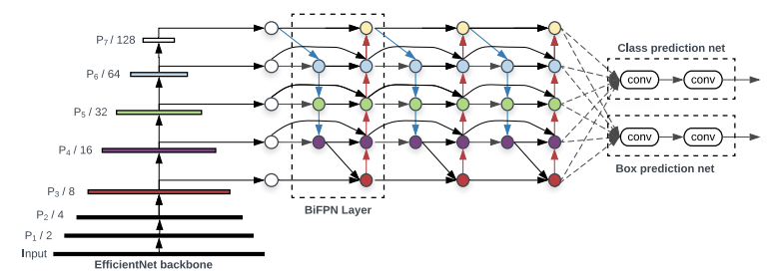
Object detection model
EfficientDet (Tan, 2020)
Backbone network: EfficientNet
Pre-trained on ImageNet
Feature network: Bidirectional Feature Pyramid Network (BiFPN)
Takes level 3-7 features from backbone network, repeatedly applies top-down and bottom-up bidirectional feature fusion
Use weighted feature fusion: network learns the importance of different input features at each scale
Class and box prediction networks
For predicting object classes and bounding boxes

Slide 14
Object detection model
EfficientDet (Tan, 2020)
Uses compound scaling
Uniformly scales the resolution, depth, and width of the backbone, BiFPN, and prediction networks
Allows model to maintain balance between accuracy and computational cost
Variant used: EfficientDet-D0
Similar accuracy as YOLOv3, RetinaNet and Mask-RCNN with much fewer parameters and FLOPs (floating point operation point)
Called from the Monk_Object_Detection library

Slide 15
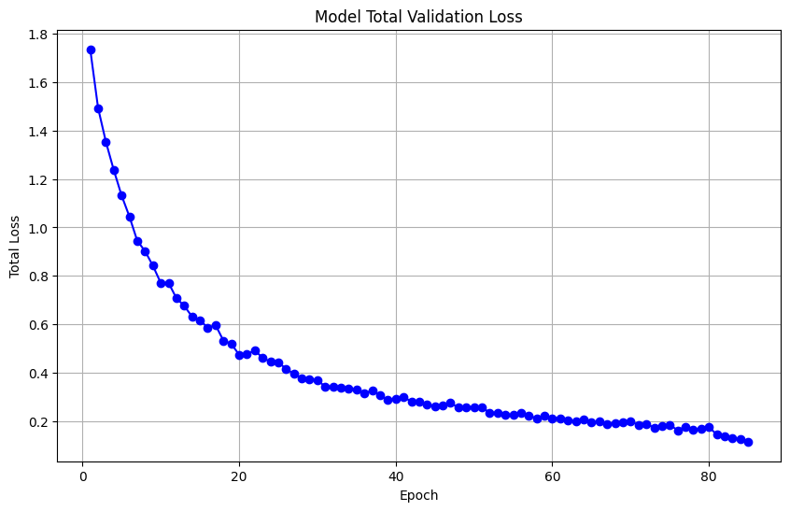
Object detection model
Validation results:
Hyperparameters used:
1. Learning rate: 0.0001
2. Early Stopping Minimum Delta: 0.01
Stop training early when there is less than 0.01 in validation loss
3. Early Stopping Patience: 3
Stop training early as soon as the next 3 epochs have no progress in validation loss.
Stopped at epoch 85
Validation loss maintains around 0.12 with very little progress
Limited GPU provided by Google Colab

Slide 16
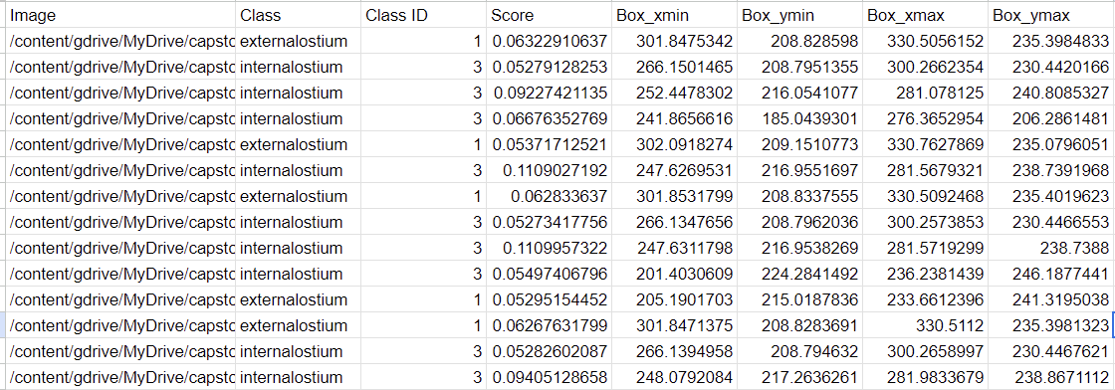
Object detection model
Out of 14 testing images, only 2 successful predictions
Perform testing on all 71 images:
20 predictions
No image that has all 3 predictors
Precision: 28%
Not good enough!

Slide 17
Next steps
To improve prediction results:
Gain access to hospital’s (RPA) data → Collect data from Viewpoint → Retrain model
Evaluate model
Fine tune model
Calculate UCA and CL
Obtain labels and build machine learning model
Build predictive machine learning model

Slide 18
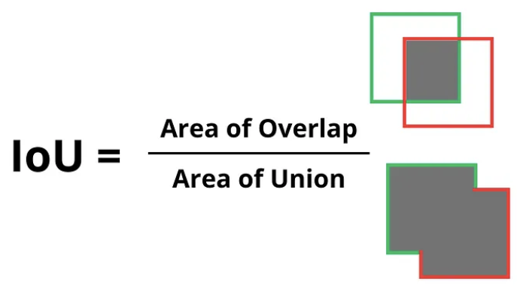



Next steps
Evaluation metrics
Intersection Over Union (IoU): shows how well bounding boxes overlap each other
Precision
Recall
F1-Score
Mean Average Precision (mAP)
Precision-recall trade-off
Evaluating an object detection model’s precision across various recall levels

Slide 19
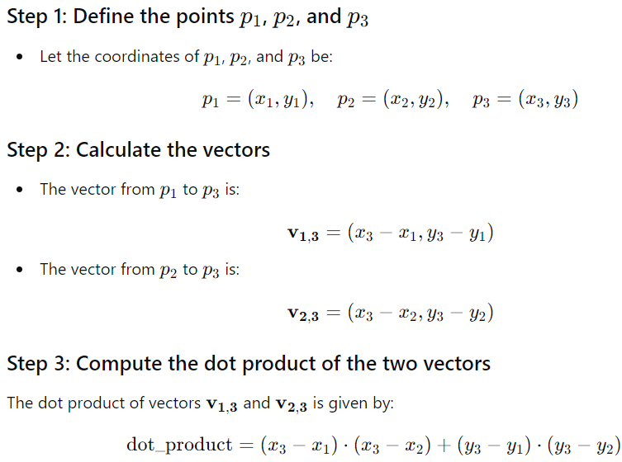


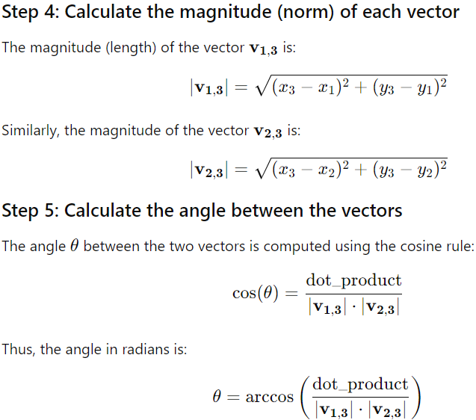

Angle and length calculation algorithm
Function to calculate UCA
Function to calculate CL
Coordinates:
Calculate vectors
Compute dot product of the 2 vectors
Magnitude of vectors
Calculate angle between vectors
Coordinates
Calculate cervical length
P1
P3
P2

Slide 20
Future trend
Use other object detection model and compare results
Add other predictors
Train with data from other hospitals

Slide 21
Thank you for listening
Special thanks to my supervisors:
Dr. Ritu Mogra
Professor Jinman
Professor Boyuan
Karina Ray

Slide 22
references
1. Brown K, Cotaru C, Binks MJ. A retrospective, longitudinal cohort study of trends and risk factors for preterm birth in the Northern Territory, Australia. BMC Pregnancy and Childbirth. 2024 Jan 5;24(1).
2. Howson EC, Kinney M, Lawn J. The Global Action Report on Preterm Birth Born Too Soon. World health organization.; 2012 Nov.
3. Dziadosz M, Bennett TA, Dolin C, West Honart A, Pham A, Lee SS, et al. Uterocervical angle: a novel ultrasound screening tool to predict spontaneous preterm birth. American Journal of Obstetrics and Gynecology. 2016 Sep;215(3):376.e1–7.
4. Giger ML. Machine Learning in Medical Imaging. Journal of the American College of Radiology. 2018 Mar;15(3):512–20.
5. Daskalakis G, Theodora M, Antsaklis P, Sindos M, Grigoriadis T, Antsaklis A, et al. Assessment of Uterocervical Angle Width as a Predictive Factor of Preterm Birth: A Systematic Review of the Literature. BioMed Research International. 2018 Dec 26;2018:1–7.
6. Sotiriadis A, Papatheodorou S, Kavvadias A, Makrydimas G. Transvaginal cervical length measurement for prediction of preterm birth in women with threatened preterm labor: a meta-analysis. Ultrasound in Obstetrics and Gynecology. 2010 Jan;35(1):54–64.
7. Khamees RE, Khattab BM, Elshahat AM, Taha OT, Aboelroose AA. Uterocervical angle versus cervical length in the prediction of spontaneous preterm birth in singleton pregnancy. International Journal of Gynecology & Obstetrics. 2021 Feb 23;156(2).
8. Singh PK, Srivastava R, Kumar I, Rai S, Pandey S, Shukla RC, et al. Evaluation of Uterocervical Angle and Cervical Length as Predictors of Spontaneous Preterm Birth. Indian Journal of Radiology and Imaging. 2022 Feb 28;32(01).
9. Luechathananon S, Songthamwat M, Chaiyarach S. Uterocervical Angle and Cervical Length as a Tool to Predict Preterm Birth in Threatened Preterm Labor. International Journal of Women’s Health. 2021 Feb;Volume 13:153–9.
10. Nguyen TTH, Vu TV, Nguyen HVQ. Uterocervical angle and cervical length measurements for spontaneous preterm birth prediction in low-risk singleton pregnant women: a prospective cohort study. Archives of Gynecology and Obstetrics. 2024 Jul 17;310(3):1611–9.
11. Farràs A. Study dataset: Real-time ultrasound demonstration of uterine isthmus contractions during pregnancy. Mendeley Data [Internet]. 2023 Jul 28 [cited 2024 Oct 15];1. Available from: https://data.mendeley.com/datasets/s27zfxgbpj/1
12. GeeksforGeeks. Evaluating Object Detection Models: Methods and Metrics [Internet]. GeeksforGeeks. 2024 [cited 2024 Oct 15]. Available from: https://www.geeksforgeeks.org/evaluating-object-detection-models-methods-and-metrics/
13. Singhal N, Mukherjee S, Perrey C. Automated assessment of endometrium from transvaginal ultrasound using Deep Learned Snake. 2017 IEEE 14th International Symposium on Biomedical Imaging (ISBI 2017). 2017 Apr 1;
14. Narra RT, Singhal N, Narayan NS, Ramaraju GA. Automated ovarian volume quantification in transvaginal ultrasound. 2018 IEEE 15th International Symposium on Biomedical Imaging (ISBI 2018). 2018 Apr;1513–6.
15. Zhao X, Liu M, Wu S, Zhang B, Arvind Burjoo, Yang Y, et al. Artificial intelligence diagnosis of intrauterine adhesion by 3D ultrasound imaging: a prospective study. Quantitative imaging in medicine and surgery. 2023 Apr 1;13(4):2314–27.
16. Wei S, Dai P, Wang Z. Cervical Cancer Detection and Diagnosis Based on Saliency Single Shot MultiBox Detector in Ultrasonic Elastography. Journal of Medical Systems. 2019 Jun 27;43(8).
17. Liu G, Tan J, Yang H, Li Y, Sun X, Wu J, et al. Breast Ultrasound Tumor Detection Based on Active Learning and Deep Learning. Communications in computer and information science. 2022 Jan 1;1700:1–10.
18. Yang T, Li P, Liu P. Efficient Automatic Detection of Uterine Fibroids Based on the Scalable EfficientDet. IEEE 16th International Conference on Anti-counterfeiting, Security, and Identification (ASID). 2022 Dec 2;
19. Nguyen JCV. Vessel recognition in ultrasound images using machine learning techniques. Borauibno [Internet]. 2023 Jun 28 [cited 2024 Oct 17]; Available from: https://bora.uib.no/bora-xmlui/handle/11250/3074216

